Slide 1

Evolutionary Architectures con .NET e MS Azure
alberto.acerbis@intre.it

Slide 3



The Fear for Distributed Architectures
Why have architects struggled with decisions in distributed architectures?
Because Software Architecture is the stuff you can’t Google Bing answers for

Slide 4

Monolithics
A monolithic architecture is a traditional model of a software program, which is built as a unified unit that is self-contained and independent from other applications.

Slide 5
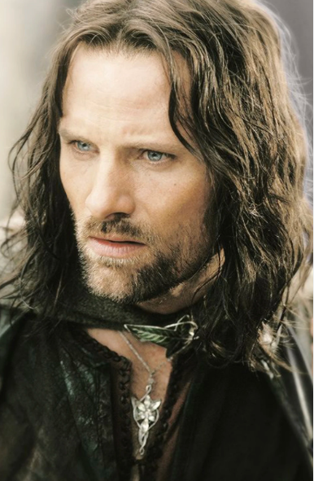
Microservices
Microservices are self-contained small services that handle specific business functions within clearly defined boundaries known as Bounded Context.

Slide 6

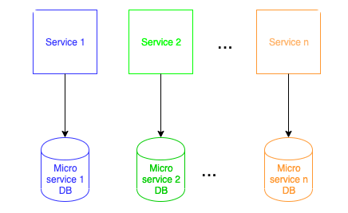
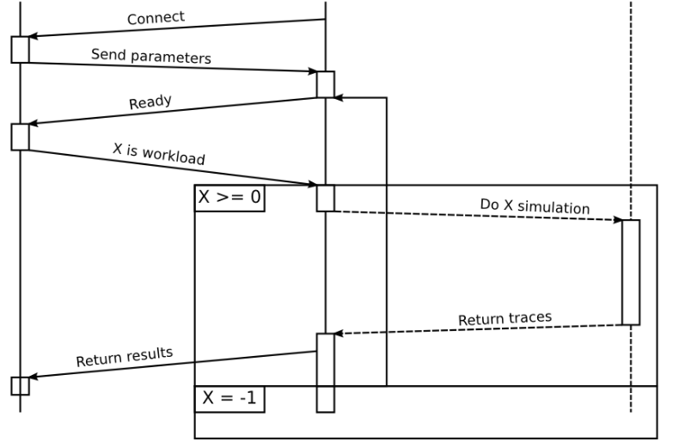
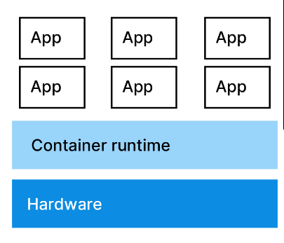
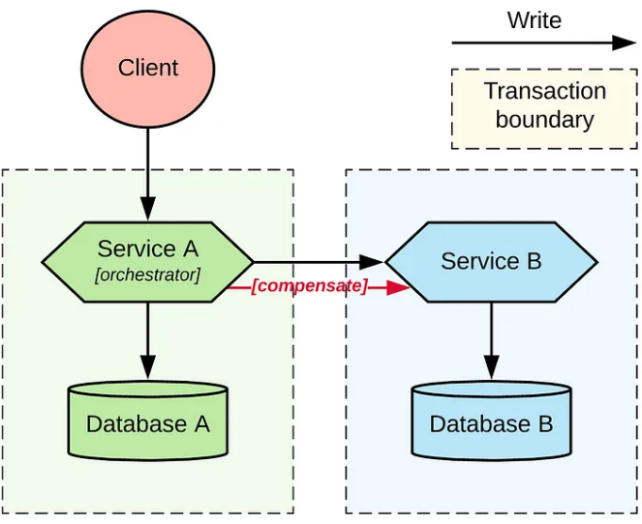
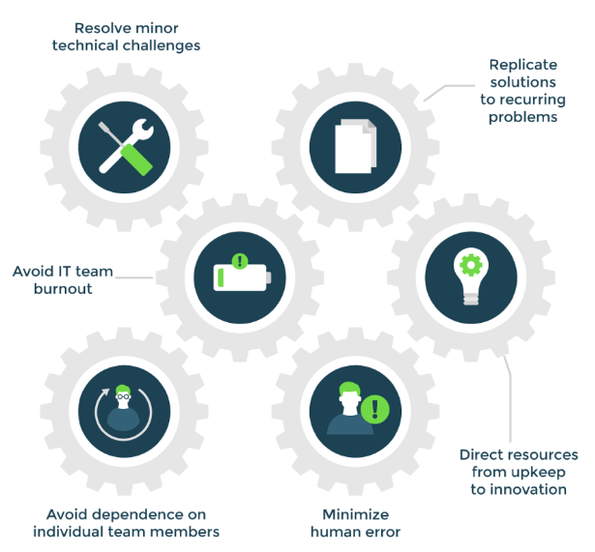
Microservices Traps
Data Decomposition
Distributed Workflow
Distributed Transaction
Operational automation
Containerization

Slide 7
What About the Dimensions?
Modularity
Granularity
Granularity
Disintegrators
Granularity
Integrators

Slide 8
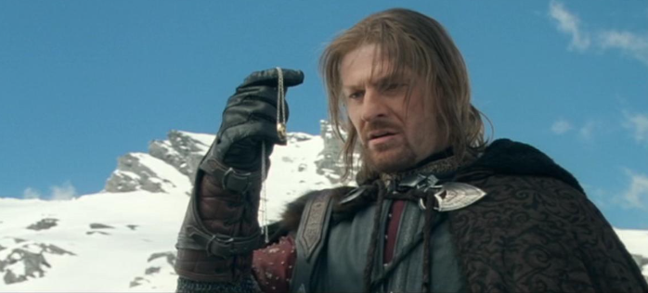
Granularity Disintegrators
Service Scope and function
Code Volatility
Fault Tolerance
Scalability and throughput
Security
Extensibility

Slide 9
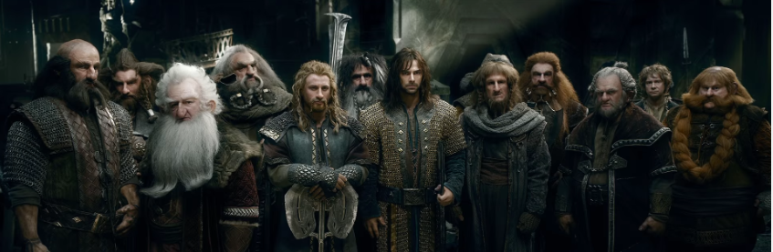
Granularity Integrators
Database Transactions
Workflow and Choreography
Shared Code
Database Relationships

Slide 10

Laws of Software Architecture
First Law
Second Law
Everything in software architecture is a trade-off
Why is more important than how
Corollary 1
If an architect thinks they have discovered something that isn’t a trade-off, more likely they just haven’t yet identified the
trade-off

Slide 11
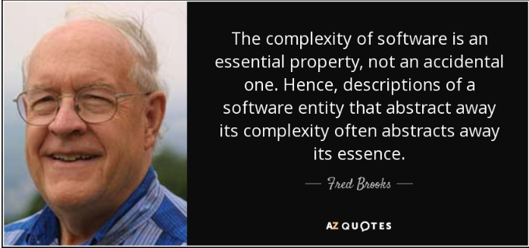
No Silver Bullet

Slide 12

Hamletic doubt
What is Essential?
What is Accidental?

Slide 13
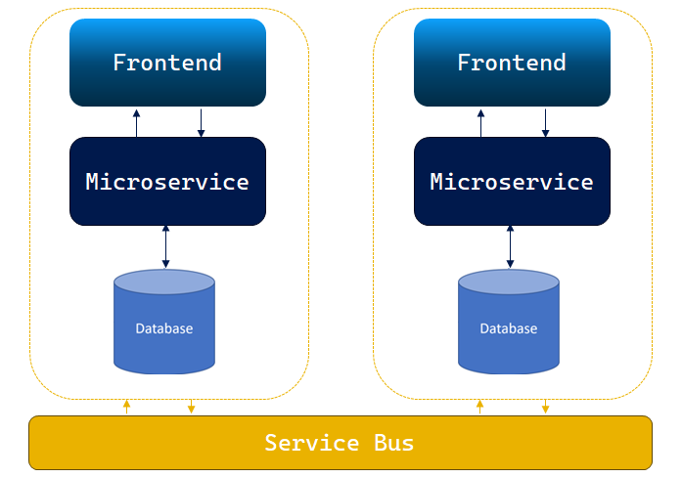

Quantum Architecture

Slide 14

Unknow Unknows
Risk comes from not knowing what you are doing
(Warren Buffet)
If you think good architecture is expensive,
try bad architecture

Slide 15

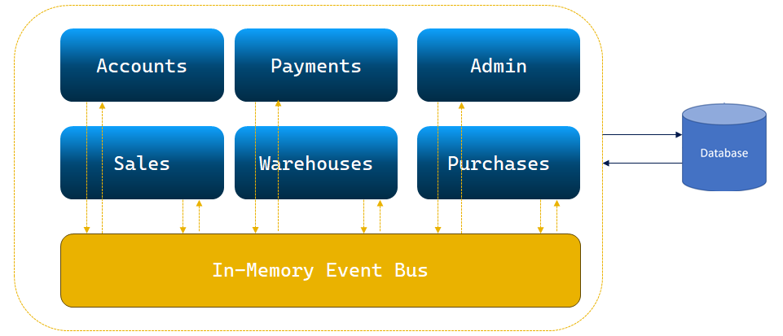
Modular Architecture

Slide 16
What is a Module?
Low Coupling
Each module should be independent of other modules in the system
High Cohesion
Components of the module are all related thus making it easier to understand what module does as a self-contained subsystem

Slide 18

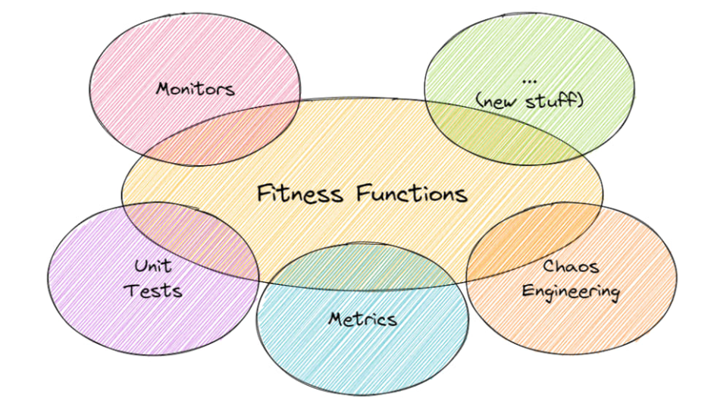
Fitness Functions
An architectural fitness function provides an objective integrity assessment of some architectural characteristic(s).

Slide 20

Ready to Deploy

Slide 24




Suggestions

Slide 25
Camera image here
Instructions:
You need to remove these rectangles
They are only there to give you a general idea of where the camera images that will record you (only when present) and the community logo (for everyone) will be overlaid.
If needed, you can add content below the camera frame. We will take care of hiding the video during that period of time.
LOGO

Slide 27
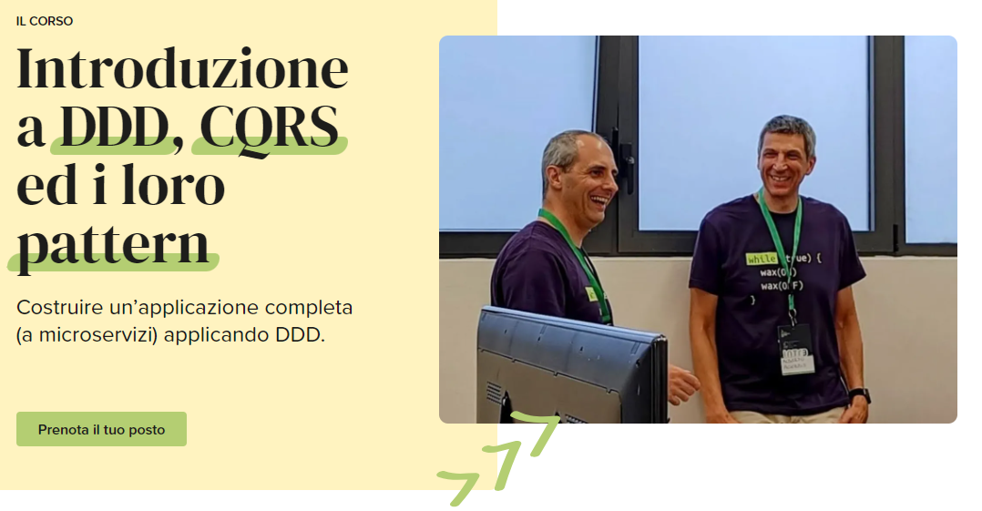






Thank You!!!
alberto.acerbis@intre.it
https://github.com/brewup
https://github.com/cqrs-muflone
https://github.com/ace68
Alberto Acerbis

